Slide 1
MODULE 3
Network Layer:

Slide 2
MODULE 3 8 Hrs
Network Layer: Network Layer Design issues, store and forward packet switching
connection less and connection oriented networks-routing algorithms-optimality principle,
shortest path, flooding, Distance Vector Routing, Control to Infinity Problem, Hierarchical
Routing, Congestion control algorithms, admission control, Classful IP addresses(A,B,C,D)
,QoS, Details of IP Packet

Slide 3

Design issues in Network Layer
COMPUTER NETWORKS - 19CS3602

Slide 4
Introduction
DAYANANDA SAGAR UNIVERSITY , DEPARTMENT OF CSE
The Network Layer is responsible for getting packets from the source to the destination.
To do so, the network layer must know about the topology of the network.
It also chooses the appropriate path in networks.
It must also take consider the situation of overloading or underloading the communication lines while choosing the routes across the networks.

Slide 5
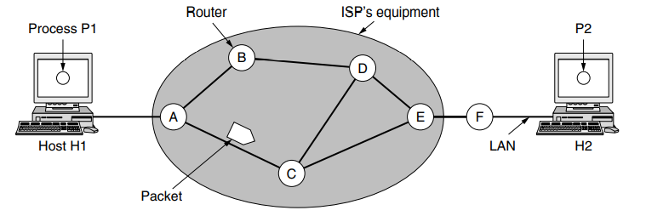
Store-and-Forward Packet Switching
DAYANANDA SAGAR UNIVERSITY , DEPARTMENT OF CSE

Slide 6
Store-and-Forward Packet Switching
DAYANANDA SAGAR UNIVERSITY , DEPARTMENT OF CSE
Consider the following network, having two hosts Host H1, and Host H2.
The major components of the network are the routers and ISP (Internet Service Providers) equipment.
H1 is directly connected to the ISP equipment where as H2 uses a router F which is outside the network.

Slide 7
Store-and-Forward Packet Switching
DAYANANDA SAGAR UNIVERSITY , DEPARTMENT OF CSE
The host transmits the packet to the nearest router.
The packet is stored there until it has fully arrived and the link has finished its processing by verifying the checksum.
Then it is forwarded to the next router along the path until it reaches the destination.
This mechanism is called store-and-forward packet switching.

Slide 8
Services provided to Transport Layer
DAYANANDA SAGAR UNIVERSITY , DEPARTMENT OF CSE
The services should be independent of the router.
The transport layer should be shielded from the number, type and topology of the routers.
The network address must be same across LANs and WANs.
The main design issues is on whether the network layer should provide connection-oriented service or connectionless service.

Slide 9
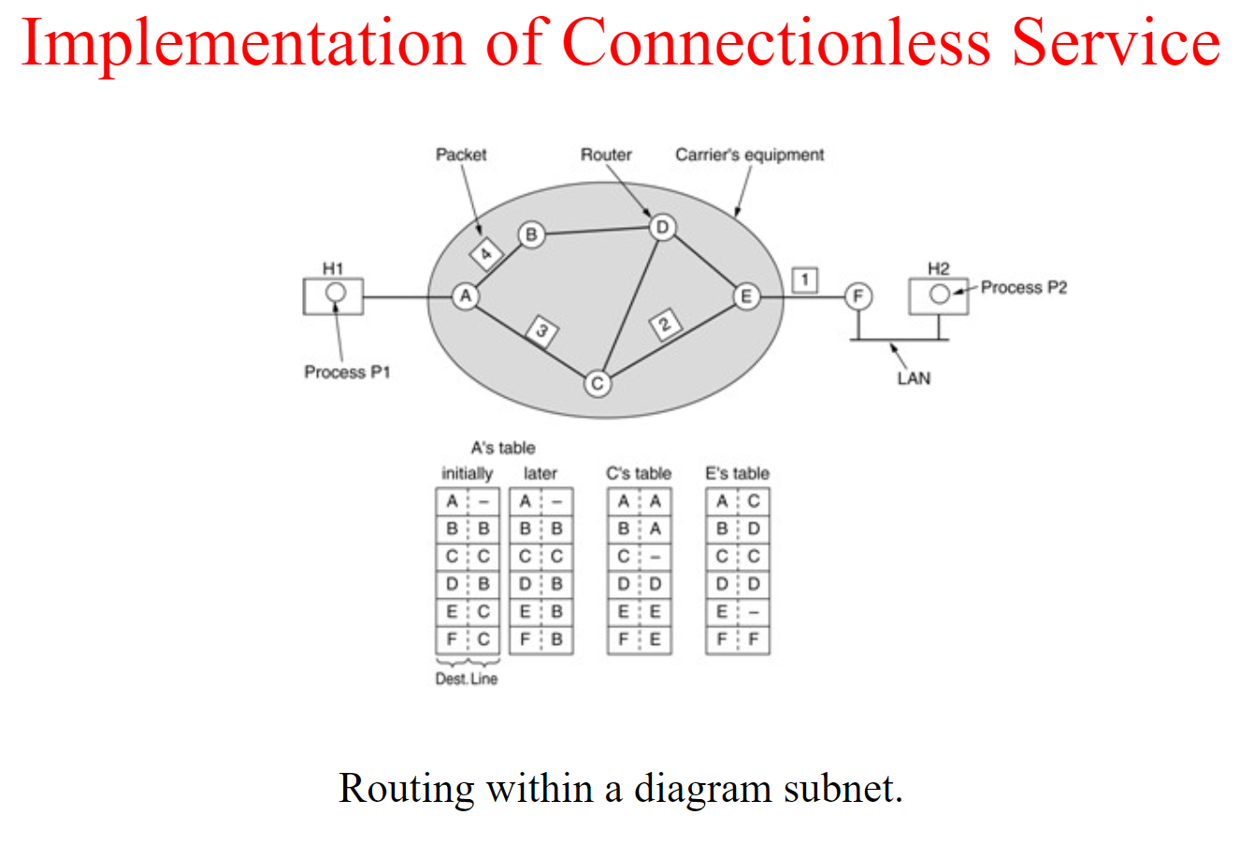

Slide 10
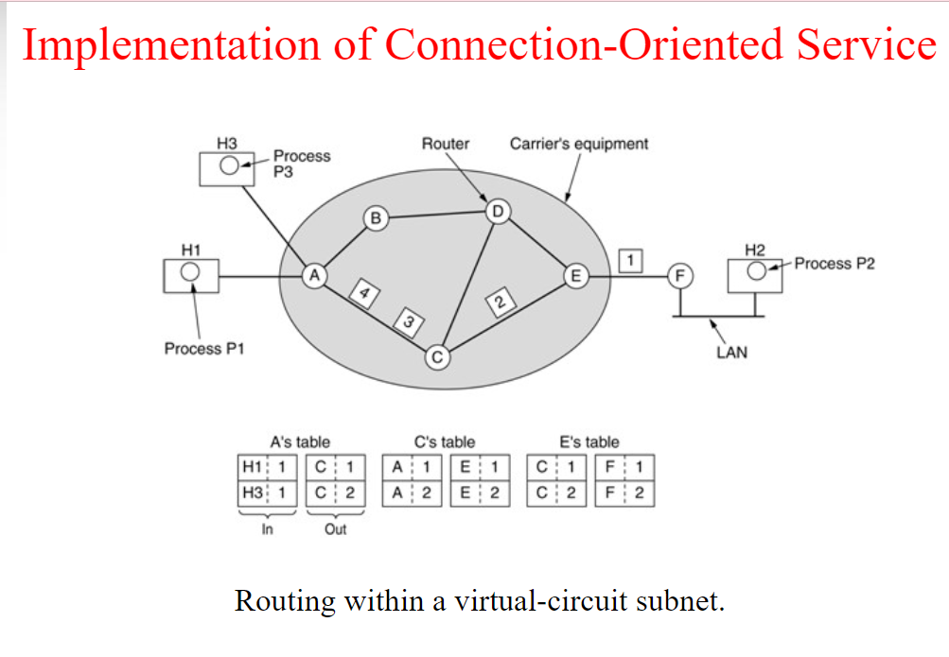

Slide 11
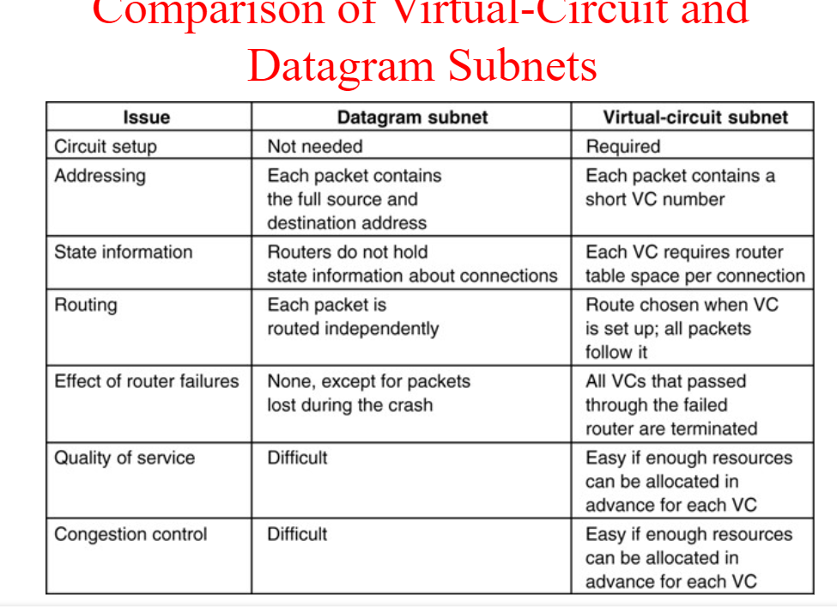

Slide 12
Asynchronous Transfer Mode (ATM) is a cell-switching, connection-oriented technology. In ATM networks, end stations attach to the network using dedicated full duplex connections. The ATM networks are constructed using switches, and switches are interconnected using dedicated physical connections.
A virtual circuit (VC) is a means of transporting data over a packet-switched network in such a way that it appears as though there is a dedicated physical link between the source and destination end systems of this data. The term virtual circuit is synonymous with virtual connection.

Slide 13
5.2 Routing Algorithms
The main function of NL (Network Layer) is routing packets from the source machine to the destination machine.
The algorithms that choose the routes and the data structures that they use are a major area of network layer design.
The routing algorithm is that part of the NL software responsible for deciding which output line an incoming packet should be transmitted on.

Slide 14
5.2 Routing Algorithms
There are two processes inside router:
One of them handles each packet as it arrives, looking up the outgoing line to use for it in the routing table. This process is forwarding.
The other process is responsible for filling in and updating the routing tables. That is where the routing algorithm comes into play. This process is routing.

Slide 15
5.2 Routing Algorithms
Regardless of whether routes are chosen independently for each packet or only when new connections are established, certain properties are desirable in a routing algorithm:
correctness, simplicity,
robustness, stability,
fairness, and optimality.

Slide 16
5.2 Routing Algorithms
Correctness and simplicity hardly require coment.
Robustness: the routing algorith should be able to cope with changes in topology and traffic without requiring all jobs in all hosts to be aborted and the network to be rebooted every time some router crashes.

Slide 17
5.2 Routing Algorithms (5)
Stability is also an important goal for the routing algorithm. A stable algorithm reaches equilibrium and stays there.
Fairness and optimality may sound obvious – surely no reasonable person would oppose them – but as it turn out, they are often contradictory goals.

Slide 18
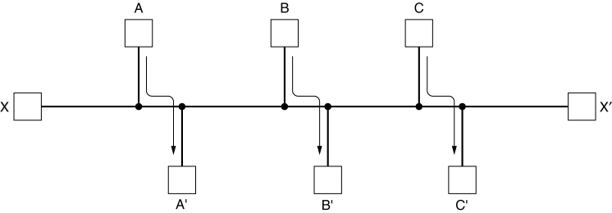
5.2 Routing Algorithms (6)
Conflict between fairness and optimality.

Slide 19
5.2 Routing Algorithms (7)
Routing algorithms can be grouped into two major classes: nonadaptive and adaptive.
Nonadaptive algorithm do not base their routing decisions on measurements or estimates of the current traffic and topology. Instead, the choice of the route to use to get from I to J is computed in advance, off line, and downloaded to the routers when the network is booted. This procedure is sometimes called static routing.

Slide 20
5.2 Routing Algorithms (8)
Adaptive algorithm, in contrast, change their routing decisions to reflect changes in the topology, and usually the traffic as well.
Adaptive algorithms differ in where they get their information (e.g., locally, from adjacent routers, or from all routers), when they change the routes (e.g., every ∆T sec, when the load changes or when the topology changes), and what metric is used for optimization (e.g., distance, number of hops, or estimated transit time). This procedure is called dynamic routing.

Slide 21
5.2 Routing Algorithms
The Optimality Principle
Shortest Path Routing
Flooding
Distance Vector Routing
Count to infinity
Hierarchical Routing

Slide 22
5.2 Routing Algorithms (10) The Optimality Principle (1)
One can make a general statement about optimal routes without regard to network topology or traffic.
This statement is known as the optimality principle.
It states that if router J is on the optimal path from router I to router K, then the optimal path from J to K also falls along the same route.

Slide 23
5.2 Routing Algorithms (11) The Optimality Principle (2)
As a direct consequence of the optimality principle, we can see that the set of optimal routes from all sources to a given destination form a tree rooted at the destination.
Such a tree is called a sink tree.
The goal of all routing algorithms is to discover and use the sink trees for all routers

Slide 24
A sink tree may not be unique.
There can exist more than one sink trees having same path length. The objective of routing algorithms is to find the sink trees for all nodes in the network.
Since, links and nodes may go down and revive during data transmission, the alternative sink trees and the paths are also made available to the nodes.
Being a tree, a sink tree does not contain any loops or cycles. So each packet can be delivered within a finite number of hops. Also, a packet will not be infinitely rotated within a subnet.

Slide 25
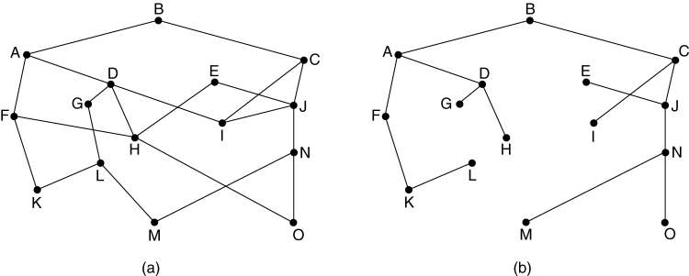
5.2 Routing Algorithms (12) The Optimality Principle (3)
(a) A subnet. (b) A sink tree for router B.

Slide 26
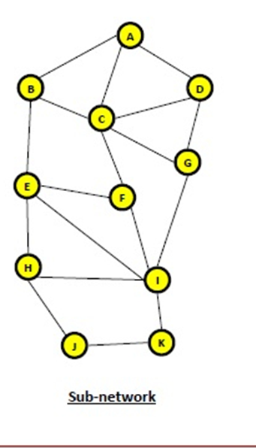

Slide 27
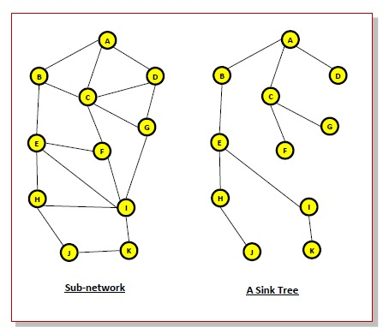

Slide 28
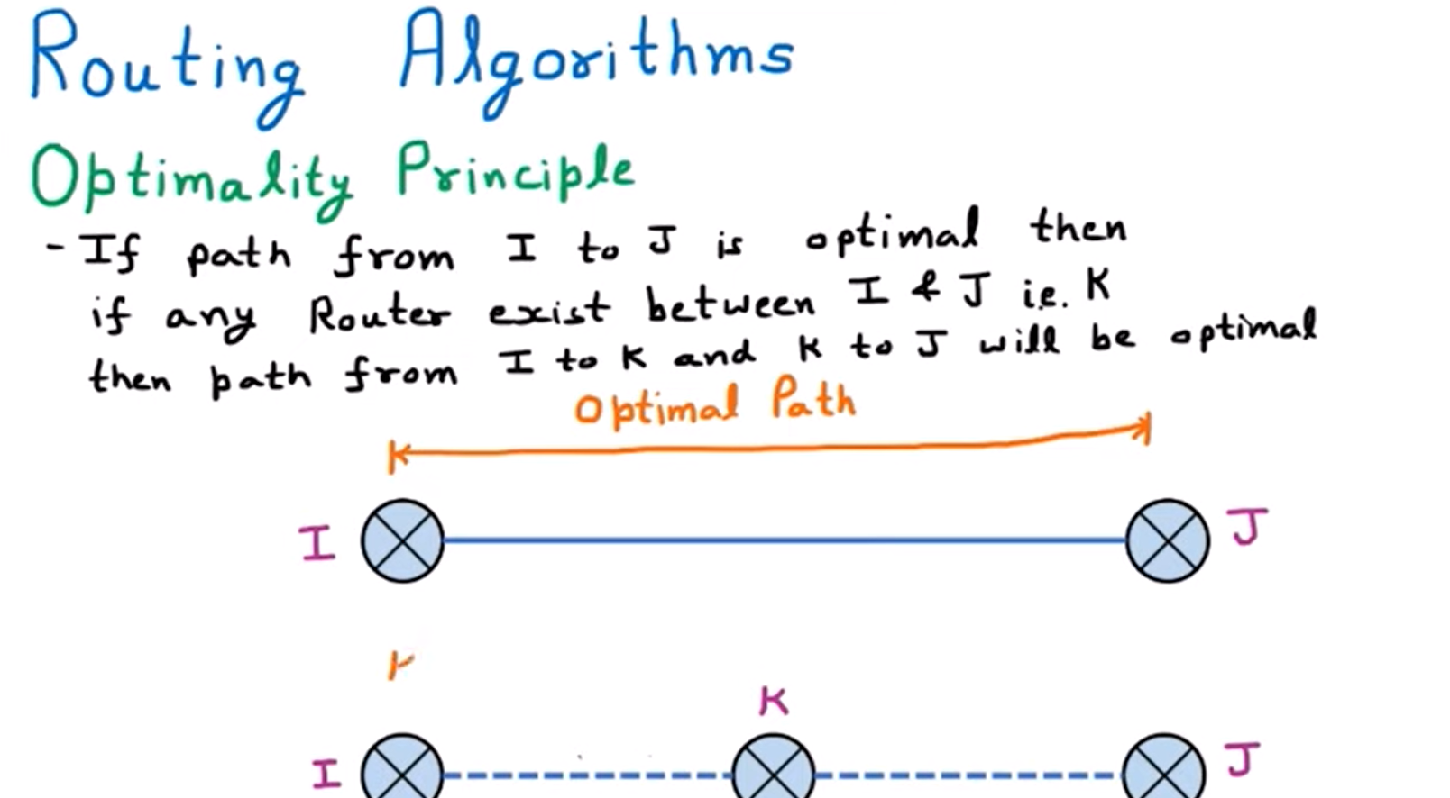

Slide 29
5.2 Routing Algorithms (13) Shortest Path Routing (1)
The idea is to build a graph of the subnet, with each node of the graph representing a router and each arc of the graph representing a communication line or link.
To choose a route between a given pair of routers, the algorithm just finds the shortest path between them on the graph.

Slide 30
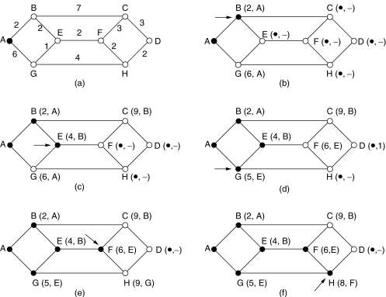
5.2 Routing Algorithms (14) Shortest Path Routing (2)
The first 5 steps used in computing the shortest path from A to D. The arrows indicate the working node.

Slide 31
5.2 Routing Algorithms Shortest Path Routing
Many other metrics besides hops and physical distance are also possible.
For example, each arc could be labeled with the mean queuing and transmission delay for some standard test packet as determined by hourly test runs.
With this graph labeling, the shortest path is the fastest path rather than the path with the fewest arcs or kilometers.

Slide 32
5.2 Routing Algorithms - Shortest Path Routing
In the general case, the labels on the arcs could be computed as a function of the distance, bandwidth, average traffic, communication cost, mean queue length, measured delay, and other factors.
By changing the weighting function, the algorithm would then compute the “shortest” path measured according to any one of a number of criteria or to a combination of criteria.

Slide 33
What is flooding?
In a computer network, flooding occurs
when a router uses a nonadaptive routing algorithm to send an incoming packet to every outgoing link except the node on which the packet arrived.
Flooding is a way to distribute routing protocols updates quickly to every node in a large network.

Slide 34
5.2 Routing Algorithms Flooding
Another static algorithm is flooding, in which every incoming packet is sent out on every outgoing line except the one it arrived on.
Flooding obviously generates vast numbers of duplicate packets, in fact, an infinite number unless some measures are taken to damp the process.

Slide 35
5.2 Routing Algorithms Flooding
One such measure is to have a hop counter contained in the header of each packet, which is decremented at each hop, with the packet being discarded when the counter reaches zero.
Ideally, the hop counter should be initialized to the length of the path from source to destination.

Slide 36
5.2 Routing Algorithms Flooding
A variation of flooding that is slightly more practical is selective flooding.
In this algorithm the routers do not send every incoming packet out on every line, only on those lines that are going approximately in the right direction.
Flooding is not practical in most applications.

Slide 37
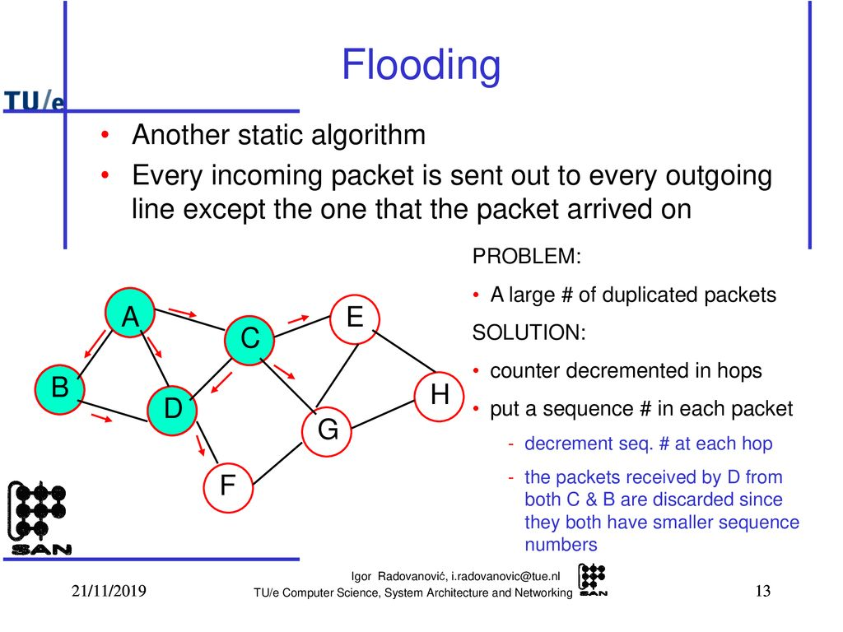

Slide 38
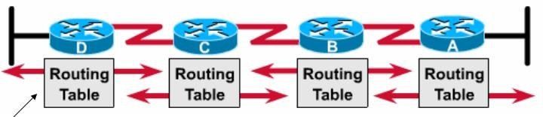
Distance Vector Routing (Bellman-Ford routing algorithm)
Dynamic routing algorithm
Operation:
Each router maintain a table (i.e., a vector) giving the best known distance to each destination and which link to use to get there.
In distance vector routing, each router periodically shares its knowledge about the entire network with its neighbors.
– The preferred outgoing line to use for that destination and an estimate of the distance to that destination. Eventually, every router knows the best link to reach each destination.

Slide 39
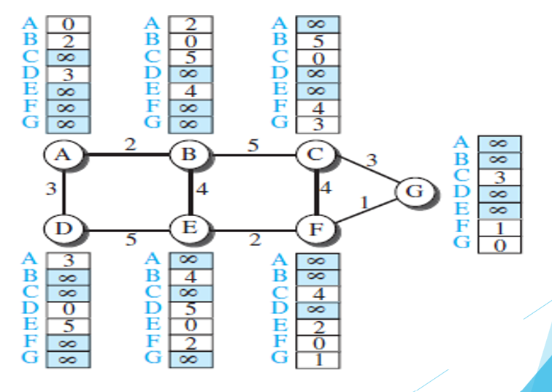
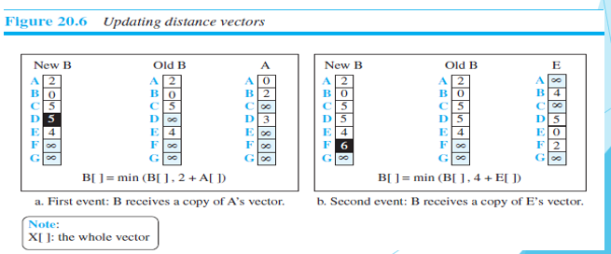

Slide 40
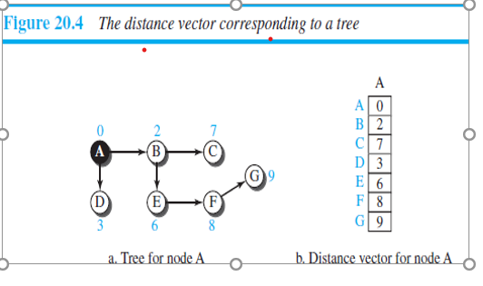

Slide 41
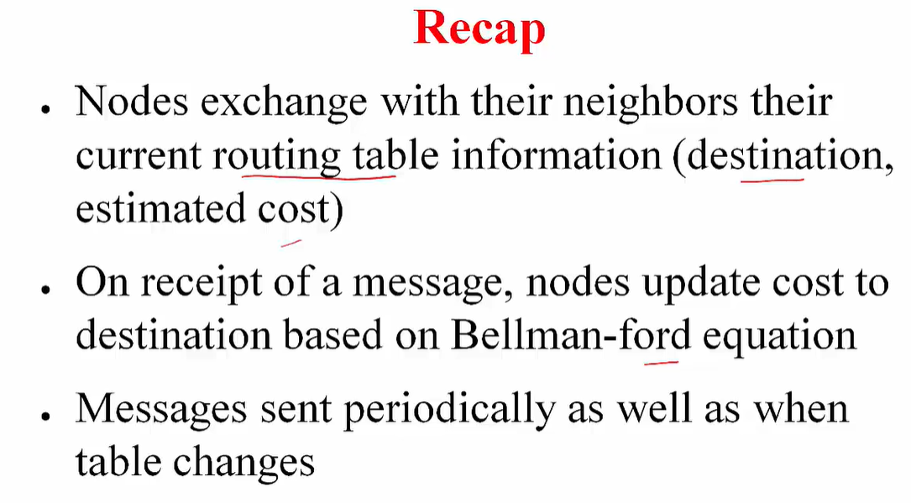

Slide 42
What is The Count to Infinity problem
The Count to Infinity problem arises from the routing loop in this Distance Vector Routing(DVR) network. Such Routing Loops usually occurs when 2 routers send an update together at the same time or when an interface goes down

Slide 43
Count to Infinity Problem
It is an issue in Distance Vector Routing
Counting to infinity is just another name for a routing loop
A problem with distance-vector routing is that any decrease in cost (good news) propagates quickly, but any increase in cost (bad news) will propagate slowly.
For a routing protocol to work properly, if a link is broken (cost becomes infinity), every other router should be aware of it immediately, but in distance-vector routing, this takes some time. The problem is referred to as count to infinity.

Slide 44
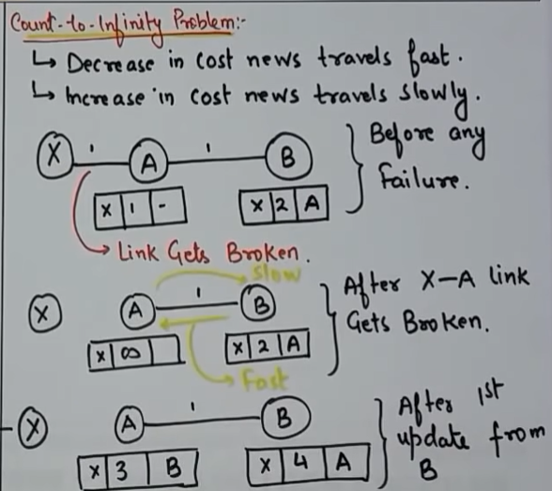
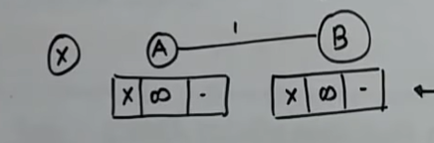

Slide 45
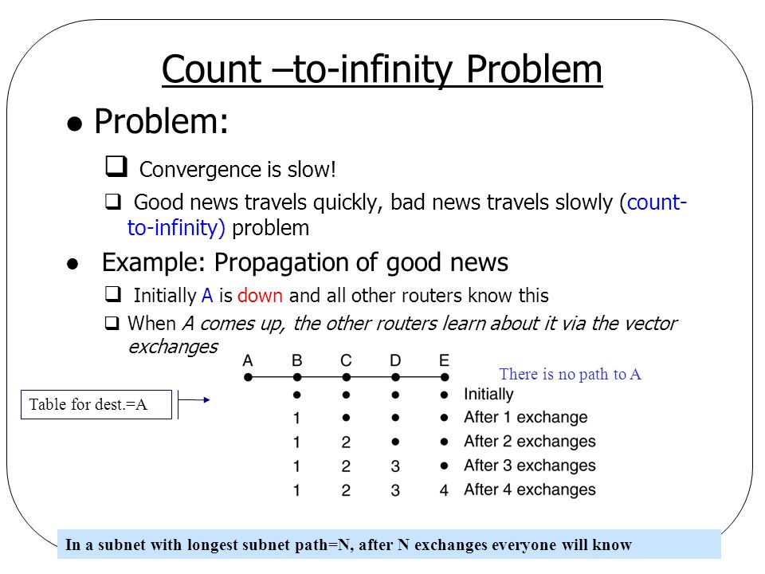

Slide 46
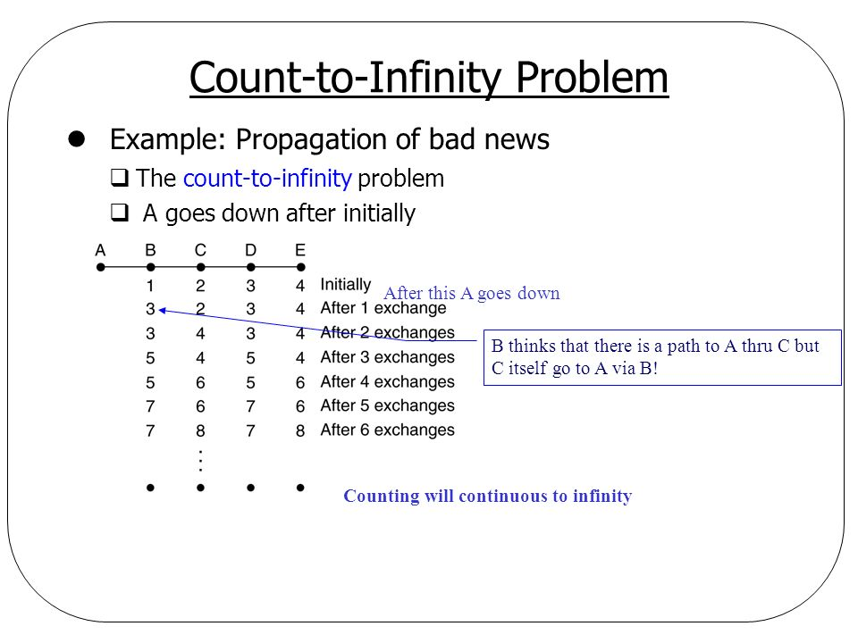

Slide 47
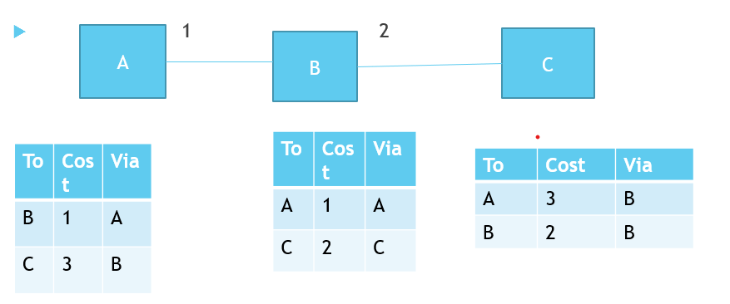
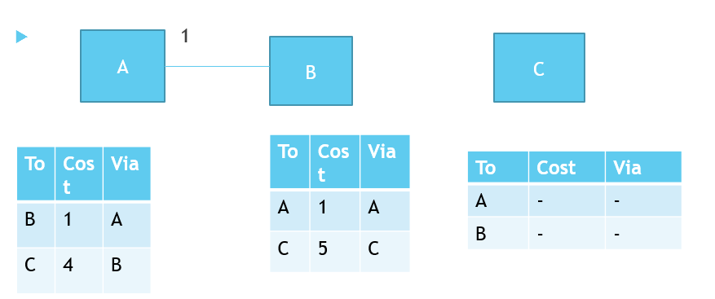

Slide 48
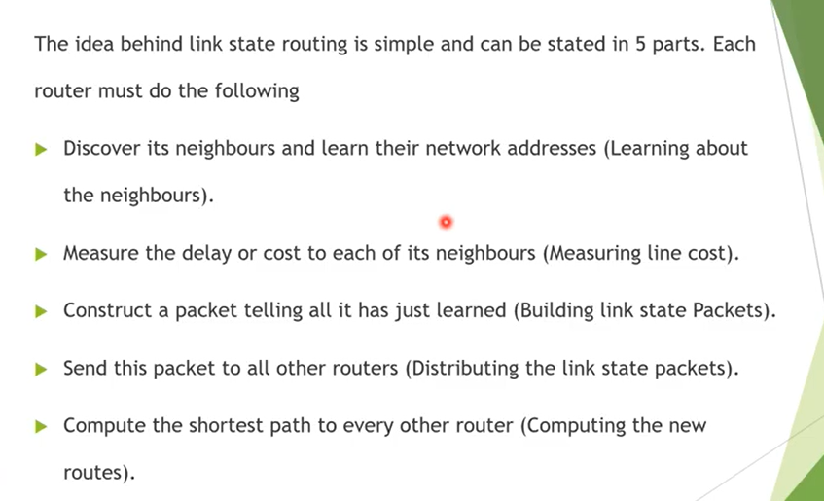
LINK STATE ROUTING

Slide 49
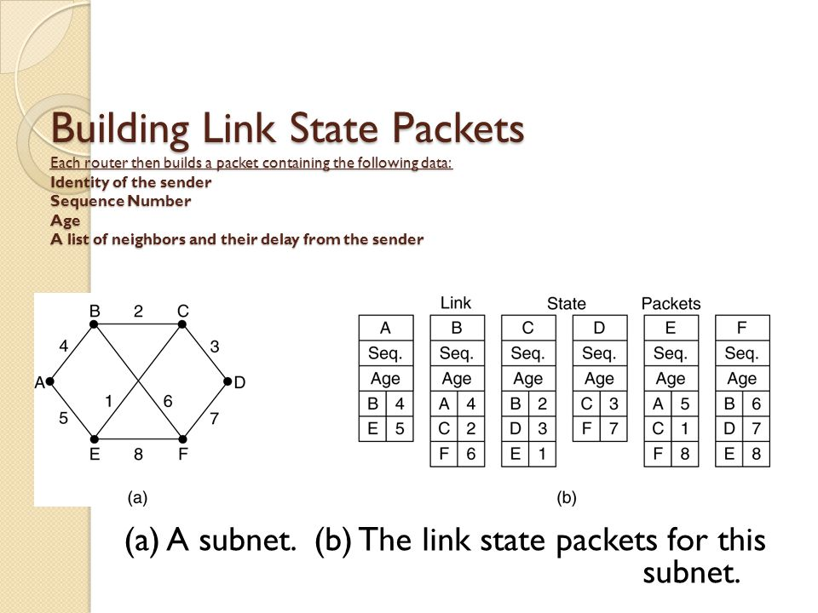

Slide 50
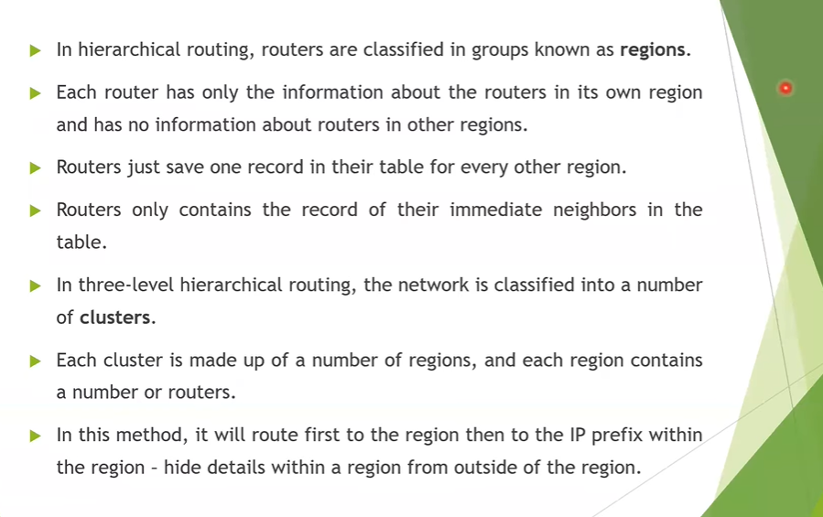
Hierarchical Routing

Slide 51
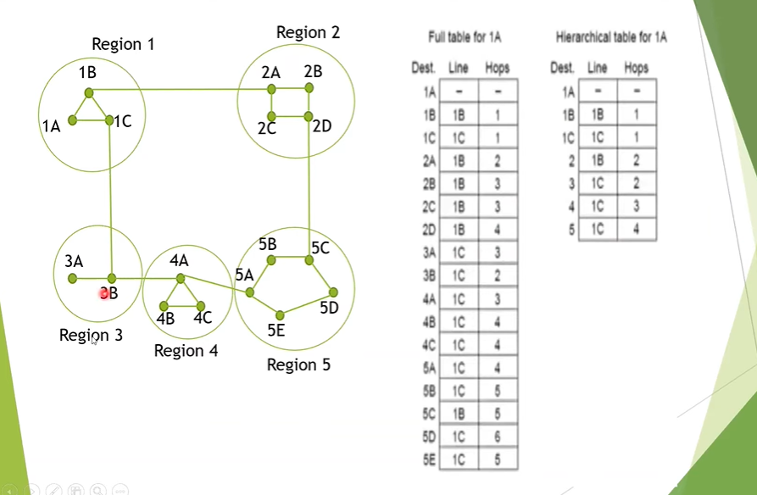
The prefix size is the number of addresses available for use. Public IP address prefixes consist of IPv4 or IPv6 addresses

Slide 52
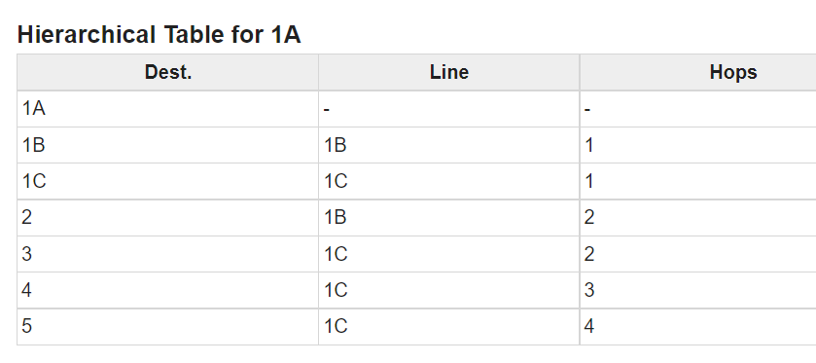
When routing is done hierarchically then there will be only 7 entries as shown below
Ration of no of regions to the number of routers per region grows, saving in table space increases.

Slide 53
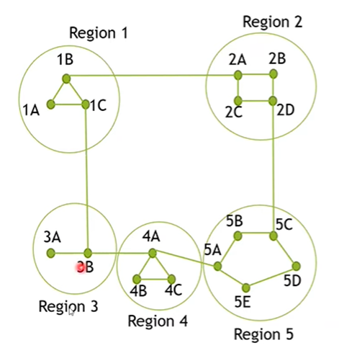
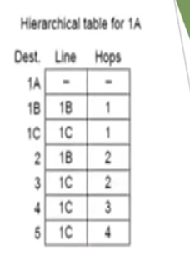
Explanation
Step 1 − For example, the best path from 1A to 5C is via region 2, but hierarchical routing of all traffic to region 5 goes via region 3 as it is better for most of the other destinations of region 5.

Slide 54
Think and solve? If the same subnet of 720 routers is partitioned into 8 clusters, each containing 9 regions and each region containing 10 routers. Then what will be the total number of table entries in each router.

Slide 55
Solution
We know that Cluster * Region * Routers = 720 We use the given formula to find minimum size of Routing table: ( Cluster-1 ) + ( Region-1 ) + Routers Therefore, here also Cluster = 8, Region = 9 & Routers = 10 ( 8-1 ) + ( 9-1 ) + 10 = 7 + 8 + 10 = 25
10 local entries + 8 remote regions + 7 clusters = 25 entries.

Slide 56
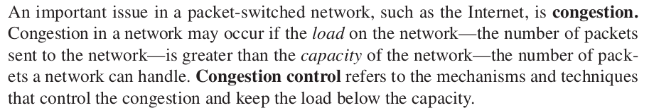
5.3. Congestion Control Algorithms
When too many packets are present in (a part of) the subnet, performance degrades.
This situation is called congestion.

Slide 57
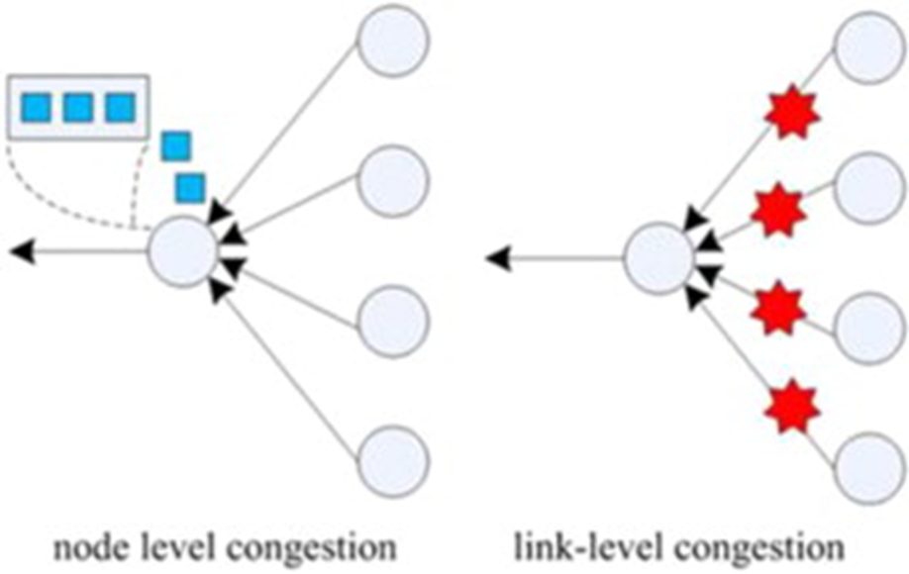
5.3. Congestion Control Algorithms
Congestion can be brought on by several factors.
If all of a sudden, streams of packets begin arriving on three or four input lines and all need the same output line, queue will build up.
If there is insufficient memory to hold all of them, packets will be lost.
Slow processors can also cause congestion
Low bandwidth line causes congestion

Slide 58
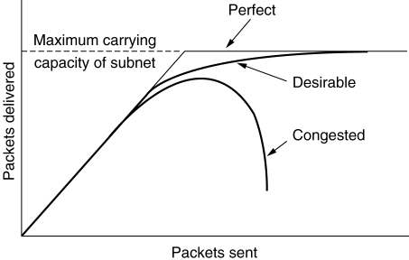
5.3. Congestion Control Algorithms Congestion
When too much traffic is offered, congestion sets in and performance degrades sharply.

Slide 59
5.3. Congestion Control Algorithms
General Principles of Congestion Control
Congestion Prevention Policies
Congestion Control in Virtual-Circuit Subnets
Congestion Control in Datagram Subnets
Load Shedding
Jitter Control

Slide 60
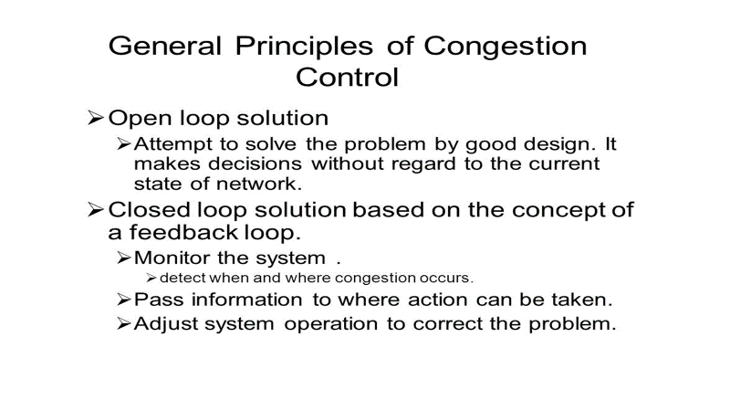

Slide 61
5.3. Congestion Control Algorithms General Principles of Congestion Control
Monitor the system .
– detect when and where congestion occurs.
Pass information to where action can be taken.
Adjust system operation to correct the problem.

Slide 62
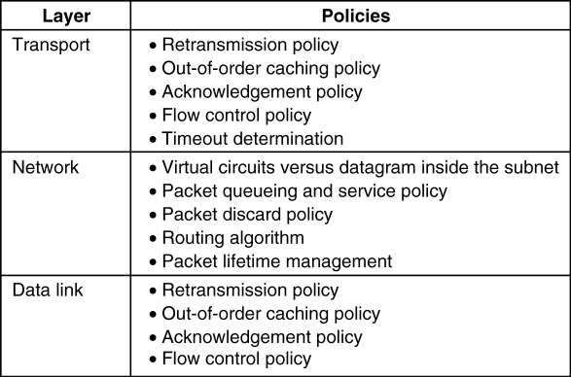
5.3. Congestion Control Algorithms Congestion Prevention Policies
5-26
79

Slide 63
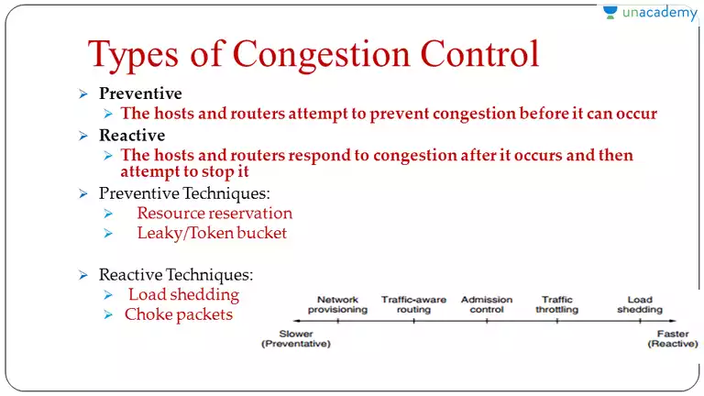

Slide 64
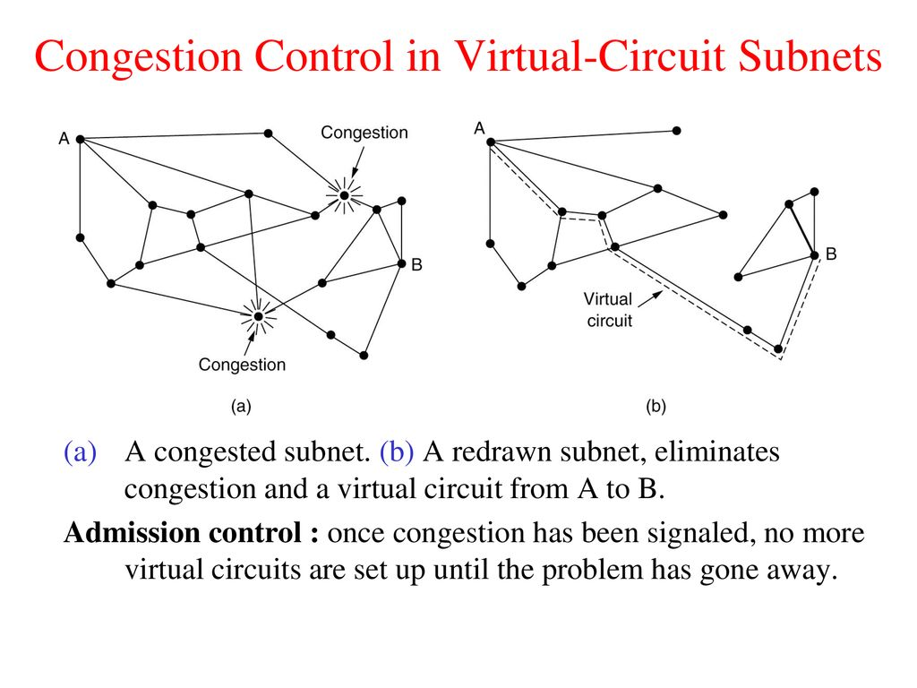

Slide 65
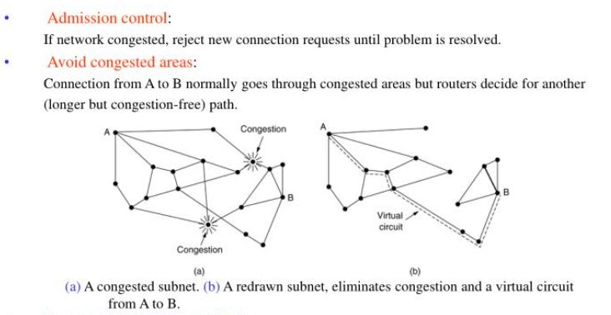

Slide 66
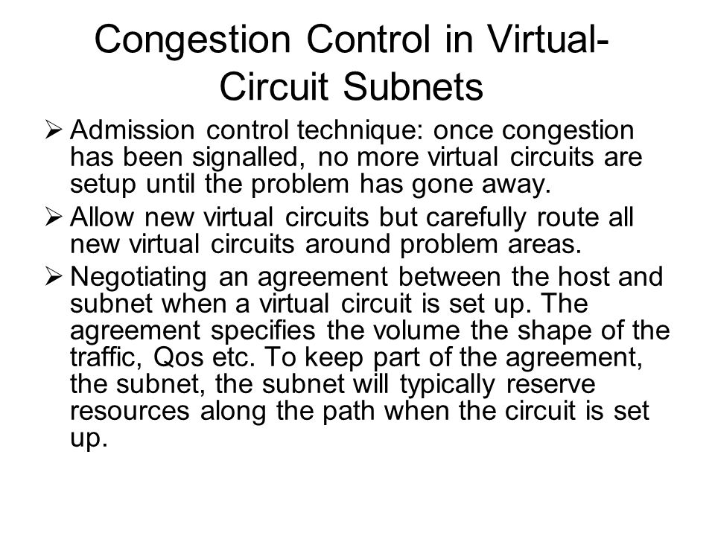

Slide 67
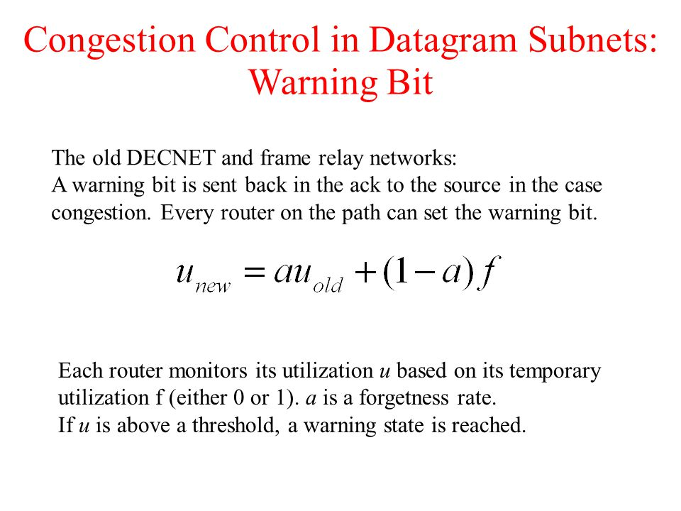

Slide 68
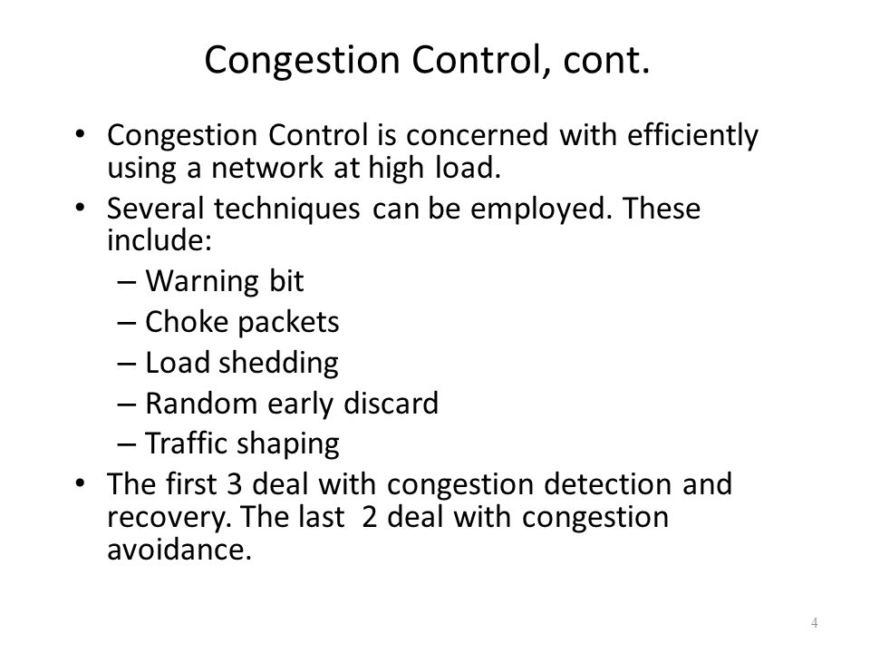
Congestion control in data-gram and sub-nets :

Slide 69
A special bit (warning bit) in the packet header is set by the router to warn the source when congestion is detected.
The bit is copied and piggy-backed on the ACK and sent to the sender.
The sender monitors the number of ACK packets it receives with the warning bit set and adjusts its transmission rate accordingly.
The usual purpose of piggybacking is simply to gain free network access rather than any malicious intent, but it can slow down data transfer for legitimate users of the network. Piggybacking is sometimes referred to as "Wi-Fi squatting

Slide 70
A choke packet
A choke packet is used in network maintenance and quality management to inform a specific node or transmitter that its transmitted traffic is creating congestion over the network.
This forces the node or transmitter to reduce its output rate.
Choke packets are used for congestion and flow control over a network

Slide 71
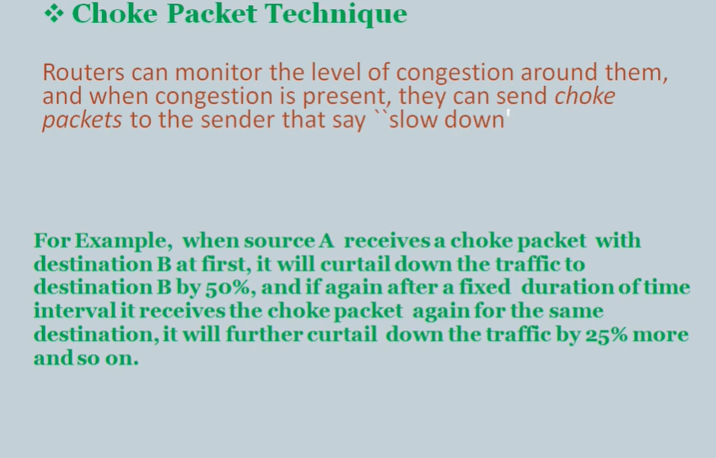

Slide 72
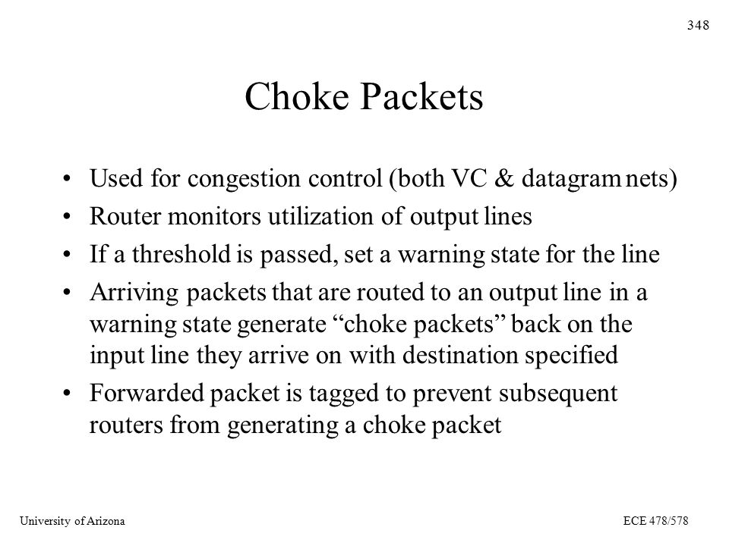
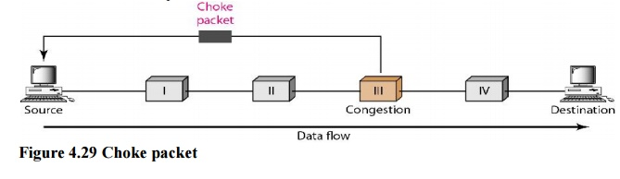

Slide 73
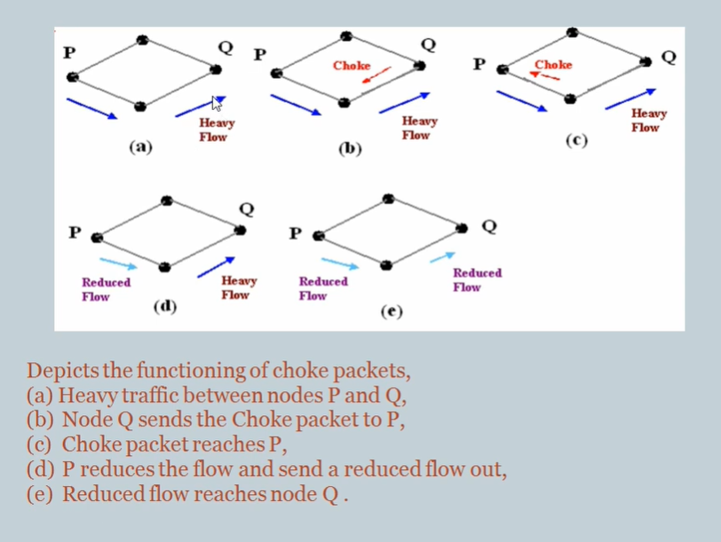

Slide 74
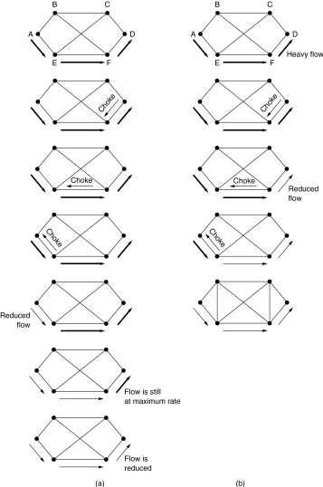
Hop-by-Hop Choke Packets
A choke packet that affects only the source.
A choke packet that affects each hop it passes through.

Slide 75
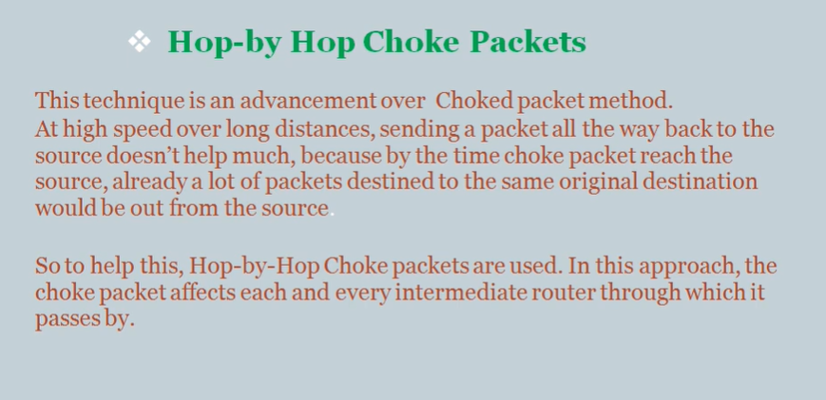

Slide 76
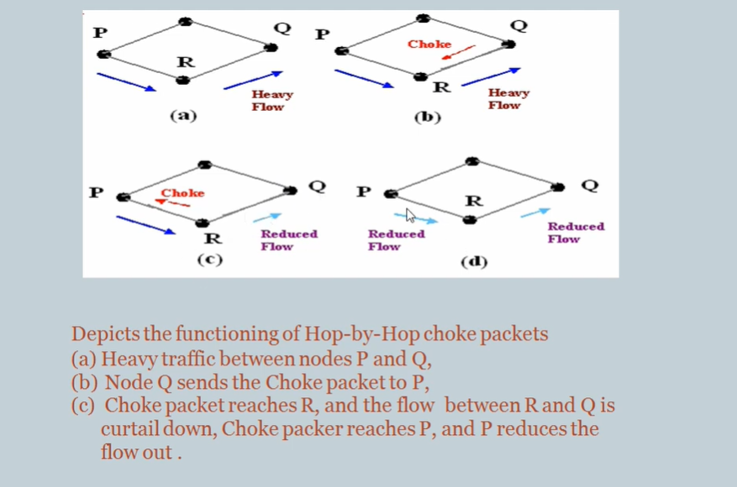

Slide 77
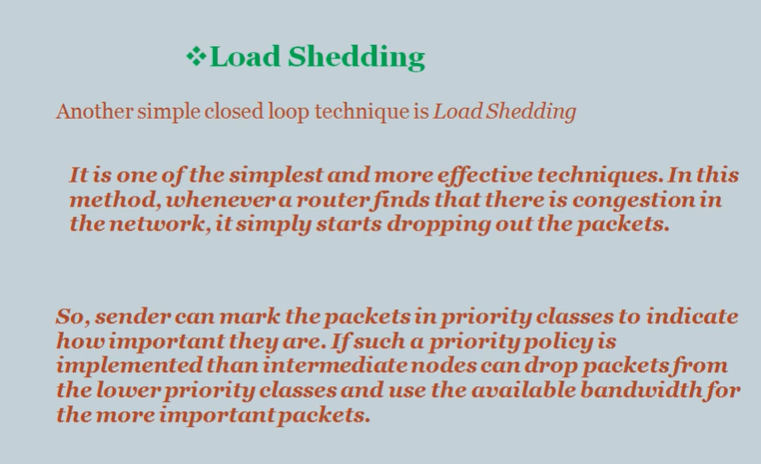

Slide 78
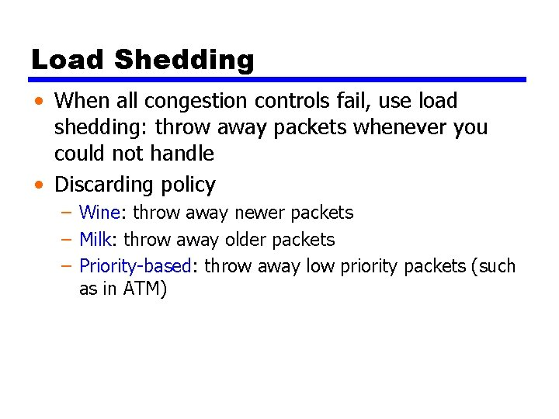

Slide 79
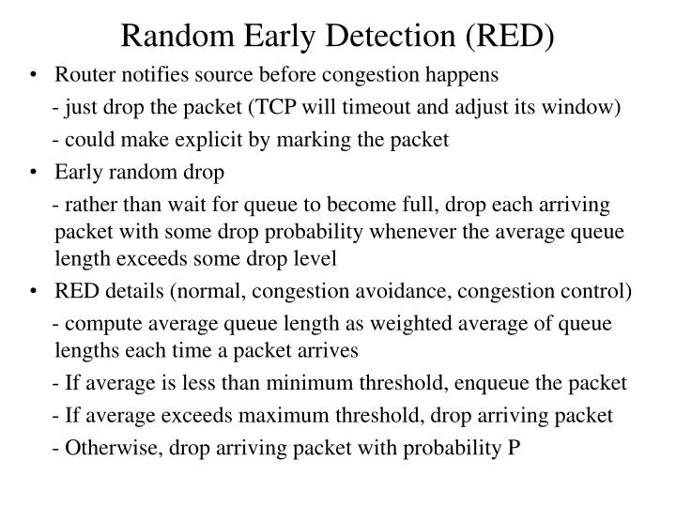

Slide 80


Slide 81


Slide 82

Jitter Control
(a) High jitter.
(b) Low jitter.

Slide 83


Slide 84

Congestion control algorithms
Leaky Bucket Algorithm:

Slide 85
In the figure, we assume that the network has committed a bandwidth of 3 Mbps for a host.
The use of the leaky bucket shapes the input traffic to make it conform to this commitment.
In Figure the host sends a burst of data at a rate of 12 Mbps for 2 s, for a total of 24 Mbits of data.
The host is silent for 5 s and then sends data at a rate of 2 Mbps for 3 s, for a total of 6 Mbits of data.
In all, the host has sent 30 Mbits of data in 10 s.
The leaky bucket smooths the traffic by sending out data at a rate of 3 Mbps during the same 10 s.
Without the leaky bucket, the beginning burst may have hurt the network by consuming more bandwidth than is set aside for this host. We can also see that the leaky bucket may prevent congestion.

Slide 86
A simple leaky bucket algorithm can be implemented using FIFO queue.
A FIFO queue holds the packets.
If the traffic consists of fixed-size packets (e.g., cells in ATM networks), the process removes a fixed number of packets from the queue at each tick of the clock.
If the traffic consists of variable-length packets, the fixed output rate must be based on the number of bytes or bits.
The following is an algorithm for variable-length packets:
Initialize a counter to n at the tick of the clock.
If n is greater than the size of the packet, send the packet and decrement the counter by the packet size. Repeat this step until n is smaller than the packet size.
Reset the counter and go to step 1.

Slide 87



Example – Let n=1000 Packet=
Since n> front of Queue i.e. n>200 Therefore, n=1000-200=800 Packet size of 200 is sent to the network.
Now Again n>front of the queue i.e. n > 400 Therefore, n=800-400=400 Packet size of 400 is sent to the network.
Since n< front of queue Therefore, the procedure is stop. Initialize n=1000 on another tick of clock. This procedure is repeated until all the packets are sent to the network.

Slide 88

Token bucket Algorithm :

Slide 89
Token bucket Algorithm :
1. In regular intervals tokens are thrown into the bucket. f
2. The bucket has a maximum capacity. ƒ
3. If there is a ready packet, a token is removed from the bucket, and the packet is sent.
4. If there is no token in the bucket, the packet cannot be sent.

Slide 90


Slide 91


Admission control

Slide 92

IP Addresses: Classful Addressing
IP address is an address having information about how to reach a specific host, especially outside the LAN. An IP address is a 32 bit unique address having an address space of 2³². Generally, there are two notations in which IP address is written, dotted decimal notation and hexadecimal notation.
Dotted Decimal Notation:

Slide 93
4.2 CLASSFUL ADDRESSING
IP addresses, when started a few decades ago, used the concept of classes. This architecture is called classful addressing. In the mid-1990s, a new architecture, called classless addressing, was introduced and will eventually supersede the original architecture. However, part of the Internet is still using classful addressing, but the migration is very fast.

Slide 94
Some points to be noted about dotted decimal notation:
The value of any segment (byte) is between 0 and 255 (both included).
There are no zeroes preceding the value in any segment (054 is wrong, 54 is correct).
Classful Addressing The 32 bit IP address is divided into five sub-classes. These are:
Class A
Class B
Class C
Class D

Slide 95
Each of these classes has a valid range of IP addresses. Classes D and E are reserved for multicast and experimental purposes respectively. The order of bits in the first octet determine the classes of IP address. IPv4 address is divided into two parts:
Network ID
Host ID
The class of IP address is used to determine the bits used for network ID and host ID and the number of total networks and hosts possible in that particular class.
Each ISP or network administrator assigns IP address to each device that is connected to its network.

Slide 96


Slide 97

Class A:
IP address belonging to class A are assigned to the networks that contain a large number of hosts.
The network ID is 8 bits long.
The host ID is 24 bits long.
The higher order bit of the first octet in class A is always set to 0. The remaining 7 bits in first octet are used to determine network ID. The 24 bits of host ID are used to determine the host in any network.
The default subnet mask for class A is 255.x.x.x. Therefore, class A has a total of:
2^7-2= 126 network ID(Here 2 address is subtracted because 0.0.0.0 and 127.x.y.z are special address. )
2^24 – 2 = 16,777,214 host ID
IP addresses belonging to class A ranges from 1.x.x.x – 126.x.x.x

Slide 98

Class B:
IP address belonging to class B are assigned to the networks that ranges from medium-sized to large-sized networks.
The network ID is 16 bits long.
The host ID is 16 bits long.
The higher order bits of the first octet of IP addresses of class B are always set to 10. The remaining 14 bits are used to determine network ID. The 16 bits of host ID is used to determine the host in any network. The default sub-net mask for class B is 255.255.x.x. Class B has a total of:
2^14 = 16384 network address
2^16 – 2 = 65534 host address
IP addresses belonging to class B ranges from 128.0.x.x – 191.255.x.x.

Slide 99

Class C:
IP address belonging to class C are assigned to small-sized networks.
The network ID is 24 bits long.
The host ID is 8 bits long.
The higher order bits of the first octet of IP addresses of class C are always set to 110. The remaining 21 bits are used to determine network ID. The 8 bits of host ID is used to determine the host in any network. The default sub-net mask for class C is 255.255.255.x. Class C has a total of:
2^21 = 2097152 network address
2^8 – 2 = 254 host address
IP addresses belonging to class C ranges from 192.0.0.x – 223.255.255.x.

Slide 100

Class D:
IP address belonging to class D are reserved for multi-casting.
The higher order bits of the first octet of IP addresses belonging to class D are always set to 1110.
The remaining bits are for the address that interested hosts recognize.
Class D does not posses any sub-net mask. IP addresses belonging to class D ranges from 224.0.0.0 – 239.255.255.255.

Slide 101


Slide 102
DETAILS OF IP PACKET
An IP packet is the smallest message entity exchanged via the Internet Protocol across an IP network.
IP packets consist of a header for addressing and routing, and a payload for user data.
The header contains information about IP version, source IP address, destination IP address, time-to-live, etc.

Slide 103
IPv4:
IPv4 is a connectionless protocol used for packet-switched networks.
It operates on a best effort delivery model, in which neither delivery is guaranteed, nor proper sequencing or avoidance of duplicate delivery is assured.
Internet Protocol Version 4 (IPv4) is the fourth revision of the Internet Protocol and a widely used protocol in data communication over different kinds of networks.
IPv4 is a connectionless protocol used in packet-switched layer networks, such as Ethernet.
It provides a logical connection between network devices by providing identification for each device.
There are many ways to configure IPv4 with all kinds of devices – including manual and automatic configurations – depending on the network type.

Slide 104
IPv4 is defined and specified in IETF publication RFC 791.
IPv4 uses 32-bit addresses for Ethernet communication in five classes: A, B, C, D and E.
Classes A, B and C have a different bit length for addressing the network host.
Class D addresses are reserved for military purposes, while class E addresses are reserved for future use.
IPv4 uses 32-bit (4 byte) addressing, which gives 2³² addresses.
IPv4 addresses are written in the dot-decimal notation, which comprises of four octets of the address expressed individually in decimal and separated by periods, for instance, 192.168.1.5.

Slide 105


